Slide 1

Walmart Analysis
By Jake, James, Yommy, Omid and Toqeer

Slide 2
Task: Gather sales insights from walmart 2010-2012 dataset. Included in our presentation will be insights into temperature vs sales, sales over time and much more…

Slide 3
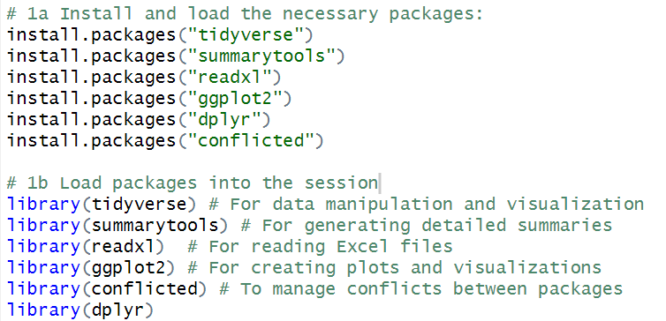
Setting up the Environment
Notes:
Using packages is a two step process
First thing is we did was install all the relevant packages
Then load them into the session, there are comments next to each to show what they are used for.

Slide 4
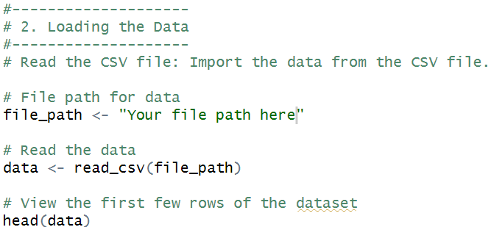
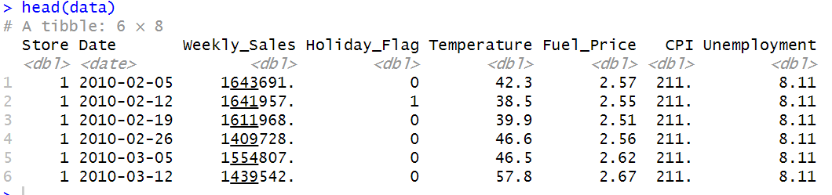
2. Loading the Data Into R
Notes:
Now to load the data into R itself
After downloading the data set from kaggle, I made sure I knew where I have saved the data as I need the file path in order for R to find it
I set the file path as a variable as it alot of characters to keep repeating
Use the read csv function to pull the data into R
(When inspecting the data within excel half of the dates changed to american date format, when I inspected the csv in notepad all the dates were of the same format)
Then used the head function to view the first few rows of the data

Slide 5
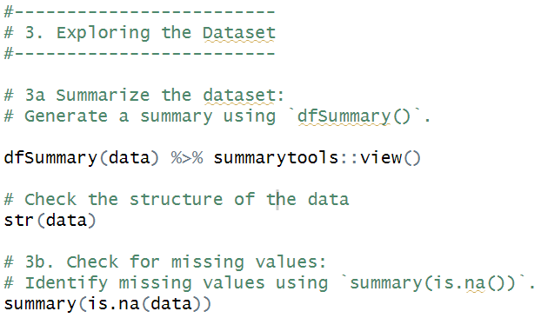
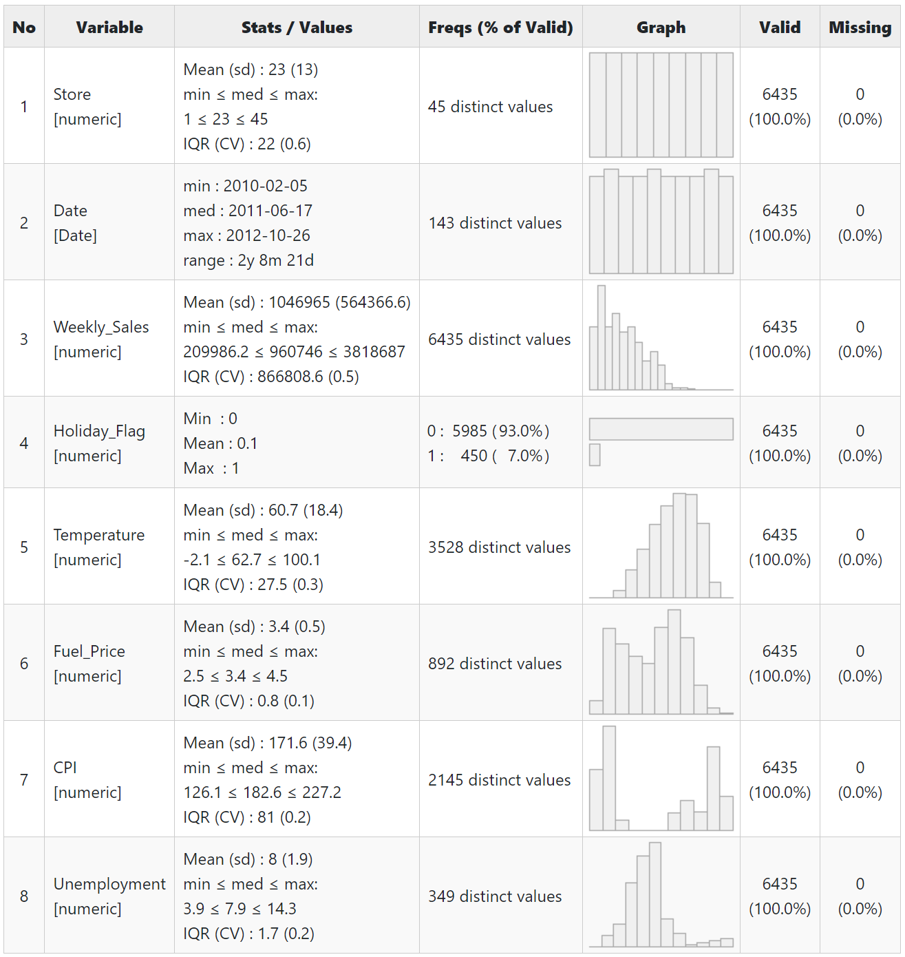
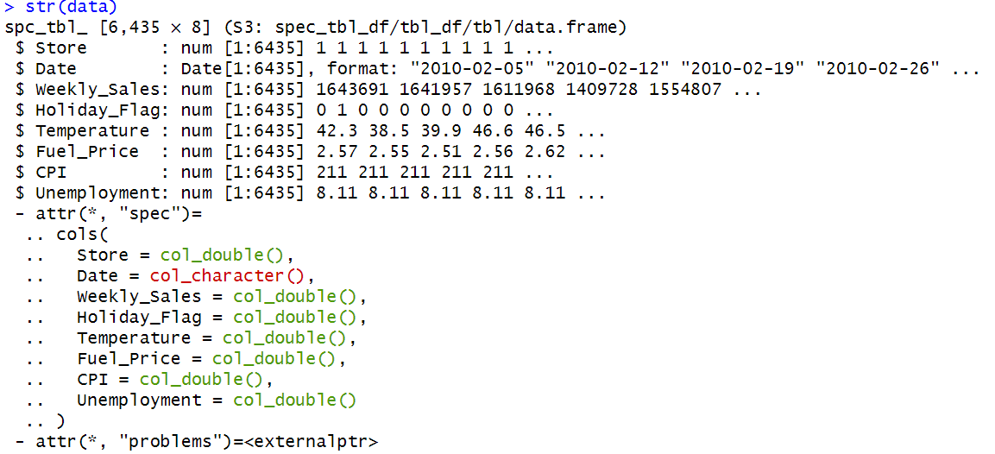
3. Exploring the Dataset
Notes:
Using the df summary function it generated a summary view that can be seen here on the right. It gives statistical analysis for each of the columns
The double colon is to explicitly specify which “view()” as there is another view within another package.
The str(data) output provides an overview of the dataset's structure, including the number of rows and columns, data types of each column, and a preview of the data in each column.
Finally the last part of the code checks for missing values. As the entire data set show False there are no missing values

Slide 6
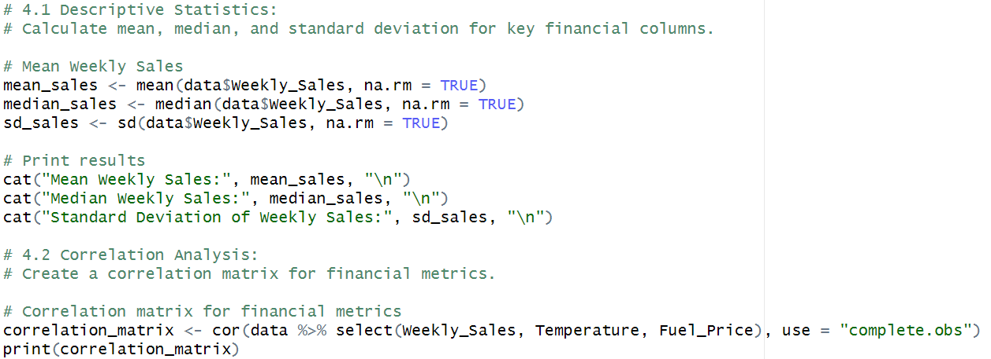
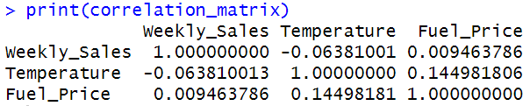
4. Statistical Analysis
Mean Weekly Sales: $1,046,965
Median Weekly Sales: $960,746
Standard Deviation of Weekly Sales: $564,366.6
Notes:
The first 3 lines of the code generate a the mean, median and standard deviation of weekly sales
The using the cat function prints them in a more readable way seen here in the purple
The last lines of code generate the correlation matrix between all fields A positive correlation between one variable and any of the other variables indicates that as one increases, so does the other.
A negative correlation indicates an inverse relationship.
A correlation value close to 0 suggests no linear relationship.

Slide 7
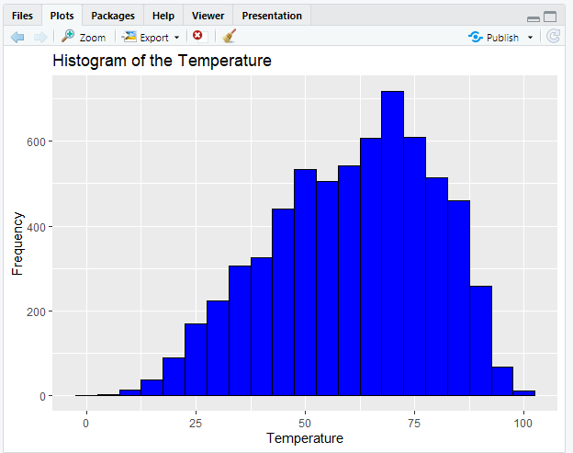
Temperature Chart
5.a Data Visualisation
ggplot(data, aes(x = `Temperature`)) +
geom_histogram(binwidth = 5, fill = "blue", color = "black") +
labs(title = "Histogram of the Temperature", x = "Temperature", y = "Frequency")
Notes:
Each store has a regular type of customer during the different type
of the region temperature and allows the weekly sales figures to be
justified.
It also shows the amount of fuel that the customer will spend on
getting to the store location.
Also the holiday event that takes place that could stop the customers
from coming to the store for shopping at that particular event time
like the U.S superbowl event if it is happening during the daytime.

Slide 8
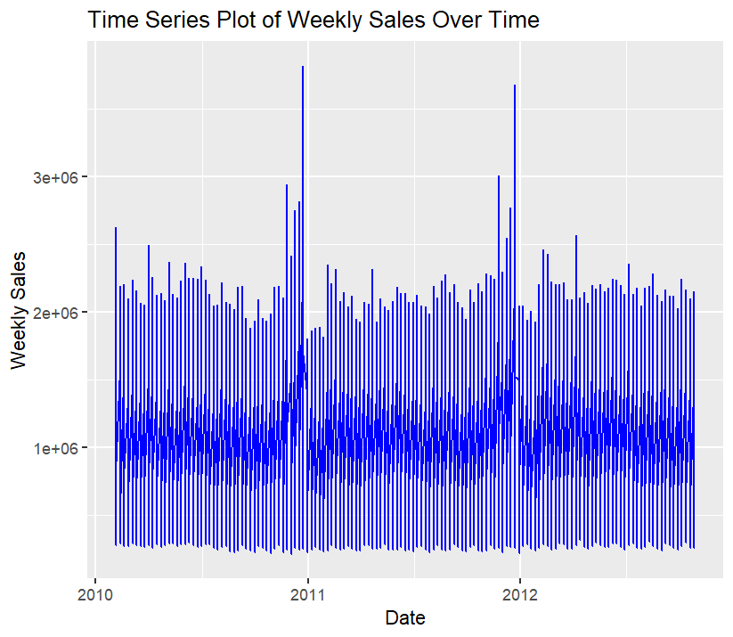
Time series
5.b Data Visualisation
ggplot(data, aes(x = Date, y = Weekly_Sales)) +
geom_line(color = "blue") +
labs(title = "Time Series Plot of Weekly Sales Over Time", x = "Date", y = "Weekly Sales")
Notes:
Anyone not familiar with scientific notation, 1e^6 is the same as 1 with 6 0s which in this case is 1 million
As you can see from this time series graph there is a peak at christmas every year for both average
Recommendations
Seasonality: If the time series plot shows clear seasonal trends, Walmart could plan inventory, staffing, and promotions to align with high and low sales periods.
Promotions: Spikes in sales might correlate with promotional activities. Understanding these can help Walmart optimize the timing and scale of future promotions.

Slide 9
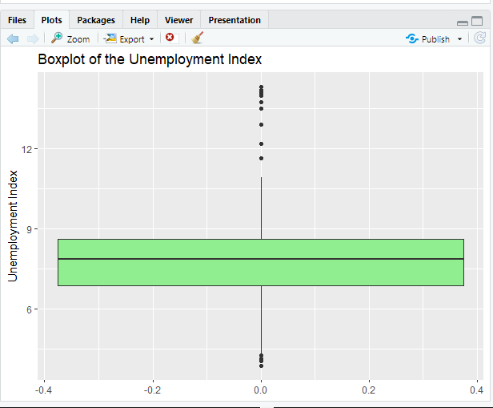
5.c Data Visualisation
ggplot(data, aes(y = `Unemployment`)) +
geom_boxplot(fill = "lightgreen") +
labs(title = "Boxplot of the Unemployment Index", y = "Unemployment Index")
This is to produce a boxplot for the Unemployment Index from the Walmart Dataset and to use the LIGHT-GREEN colour for the display of the information plot.

Slide 10
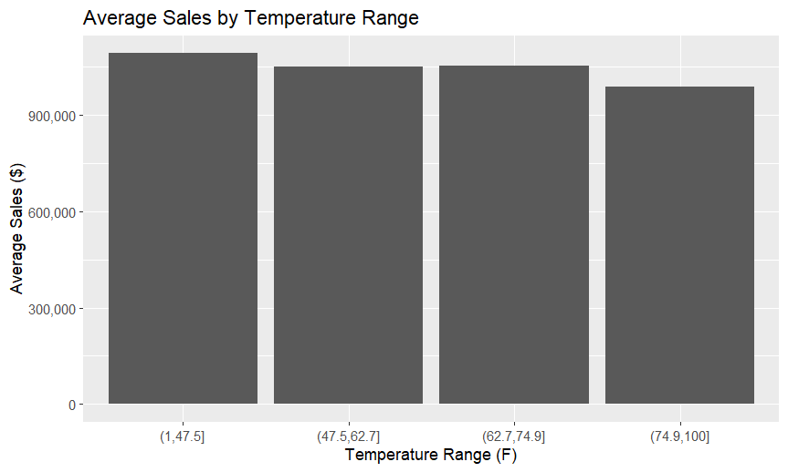
Graph Displaying Average Sales by Temperature Range
5.d Data Visualisation
This graph uses a series of predefined temperature ranges using the cut and quantile functions to analyse how aggregated average sales are affected by temperature.
temperature_ranges <- cut(walmart_data$Temperature, breaks = c(min(walmart_data$Temperature), quantile(walmart_data$Temperature, c(0.25, 0.5, 0.75, 1)), include = TRUE))
average_sales_by_temp <- aggregate(Weekly_Sales ~ temperature_ranges, walmart_data, FUN = mean)
ggplot(average_sales_by_temp, aes(x = temperature_ranges, y = Weekly_Sales)) + geom_bar(stat = "identity") + scale_y_continuous(labels = function(x) format(x, scientific = FALSE, big.mark = ",")) + labs(title = "Average Sales by Temperature Range", x = "Temperature Range (F)", y = "Average Sales ($)")
Notes:
Using information on daily temperature variables, we were able to aggregate data to create insights based on average sales for days in a given temperature range. The data demonstrates that, generally speaking, average sales are increased within lower temperature quartiles. Further analysis can be carried out to account for outliers (e.g. Christmas, Thanksgiving), to ascertain whether these trends are independent of these periods.

Slide 11
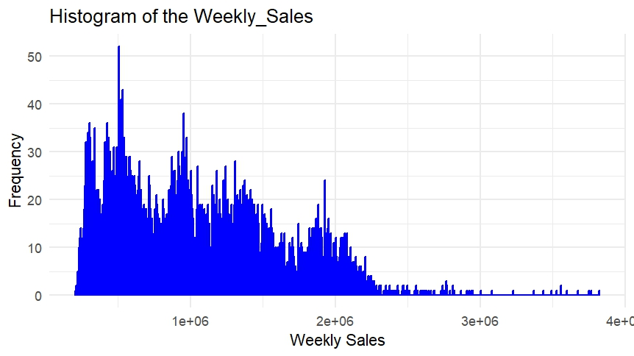
Weekly sales for Walmart
Syntax for histogram :
ggplot(data, aes(x = Weekly_Sales)) +
geom_histogram(binwidth = 5000, fill = "black", color = "blue") +
labs(title = "Histogram of the Weekly_Sales", x = "Weekly Sales", y = "Frequency") +
theme_minimal()
As you can see the histogram chart was accumulated by using the above syntax. Now what this tells us about is that the weekly sales for walmart are changing from high to low.

